Slide 1
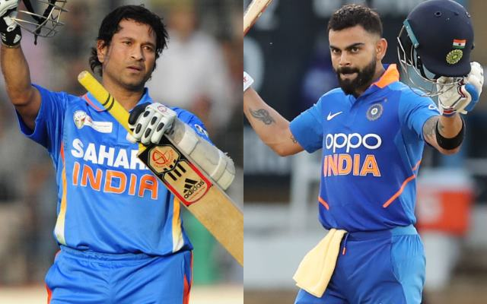
CASE STUDY: SACHIN vs VIRAT

Slide 2
CONCLUSION
Runs Per Innings:
Virat Kohli = 2.03
Sachin Tendulakar = 1.94

Slide 3
CONCLUSION
Strike Rate:
Virat Kohli = 1.12
Sachin Tendulakar = 1.22

Slide 4
CONCLUSION
Matches for a 100:
Virat Kohli = 0.18
Sachin Tendulakar = 0.15

Slide 5
CONCLUSION
Matches for a 50:
Virat Kohli = 0.55
Sachin Tendulakar = 0.57

Slide 6
CONCLUSION
Team Contribution:
Virat Kohli = 17.6%
Sachin Tendulakar = 16.9%

Slide 7
CONCLUSION
This can be done by comparing normalized values for both:
Parameter | Sachin | Virat | Winner
Runs Per Innings | 1.94 | 2.03 | Virat
Strike Rate | 1.22 | 1.12 | Sachin
100’s Per Match | 0.15 | 0.18 | Sachin
50’s Per Match | 0.57 | 0.55 | Virat
Team Contribution | 16.90% | 17.61% | Virat

Slide 8
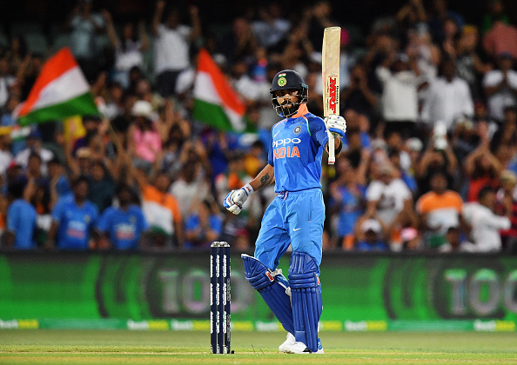
So the winner is
VIRAT KOHLI !!

